Slide 1

Sign Language interpretation gloves
Real-time gesture Recognition based on Edge AI
Dankao Chen
Connected Environments
GitHub: https://github.com/Reikimen/CASA0018-Gloves-Edge-AI

Slide 2

Research background and Motivation
About 430 million people have varying degrees of hearing impairment (World Health Organization, 2023)
Existing solutions:
Visual recognition technology: affected by environment, lighting, occlusion (Min et al., 2021).
Wearable devices: advantages in privacy protection, environmental adaptability, real-time usage
"This project aims to develop a wearable device that translates sign language in real-time, helping the hearing impaired communicate better with others"

Slide 3
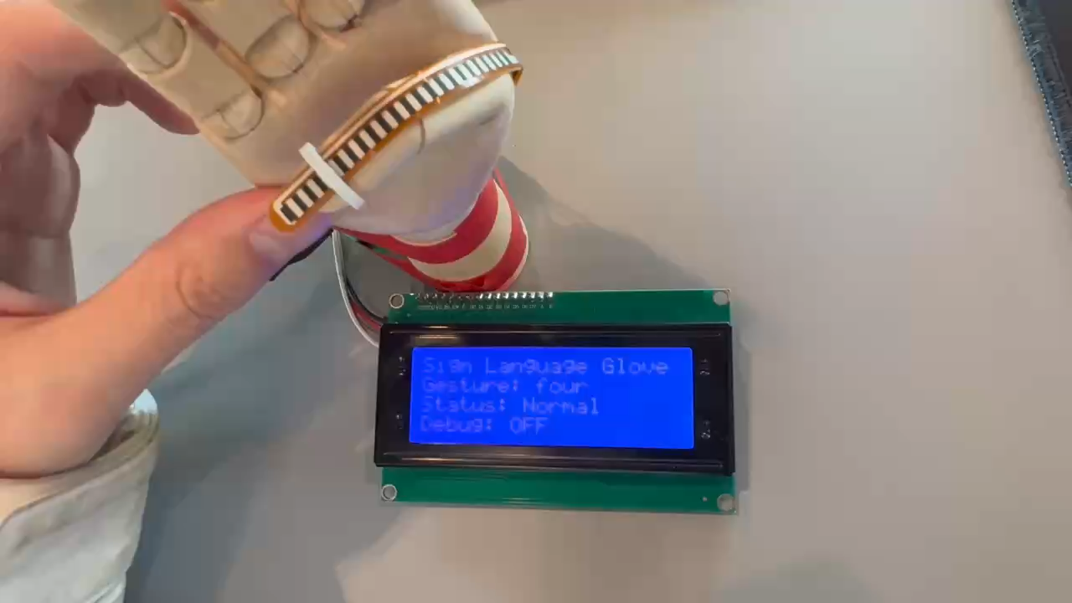
Showcase

Slide 4
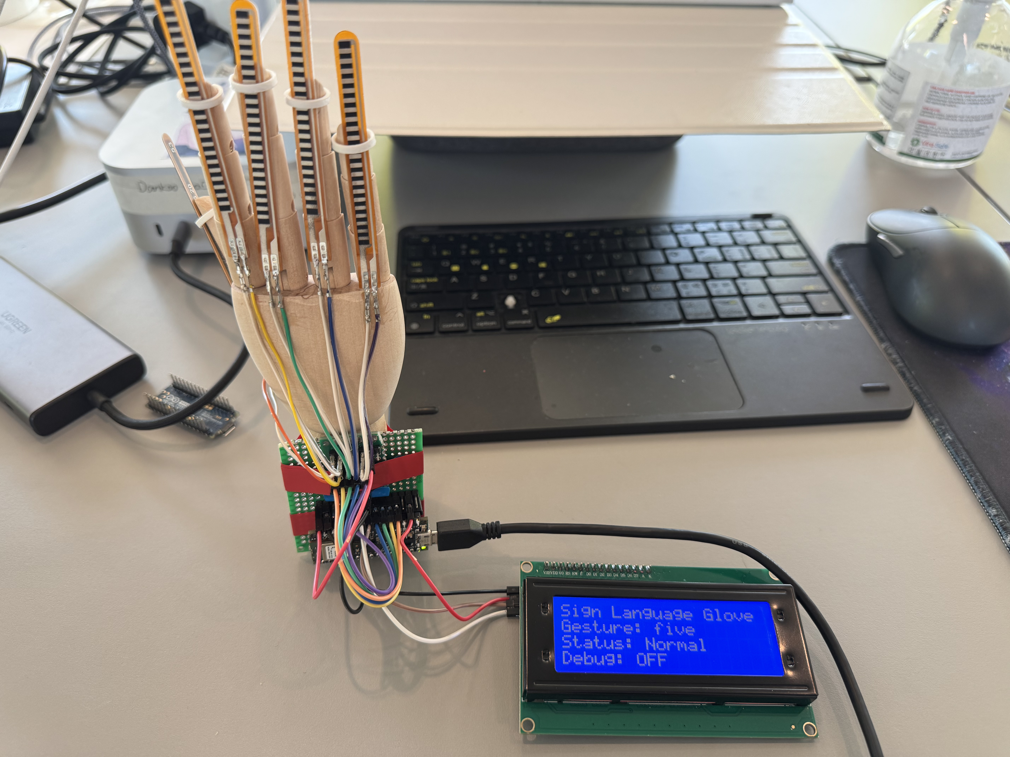
System Design & Implementation
Hardware Components:
Arduino Nano 33 BLE (with built-in IMU)
5 flex sensors (one for each finger)
LCD2004 I2C display
Custom glove structure
Software Framework:
Sensor data acquisition and preprocessing
Feature extraction (7 statistical features × 5 sensors)
Edge machine learning inference (Edge Impulse)
User interface and feedback system

Slide 5
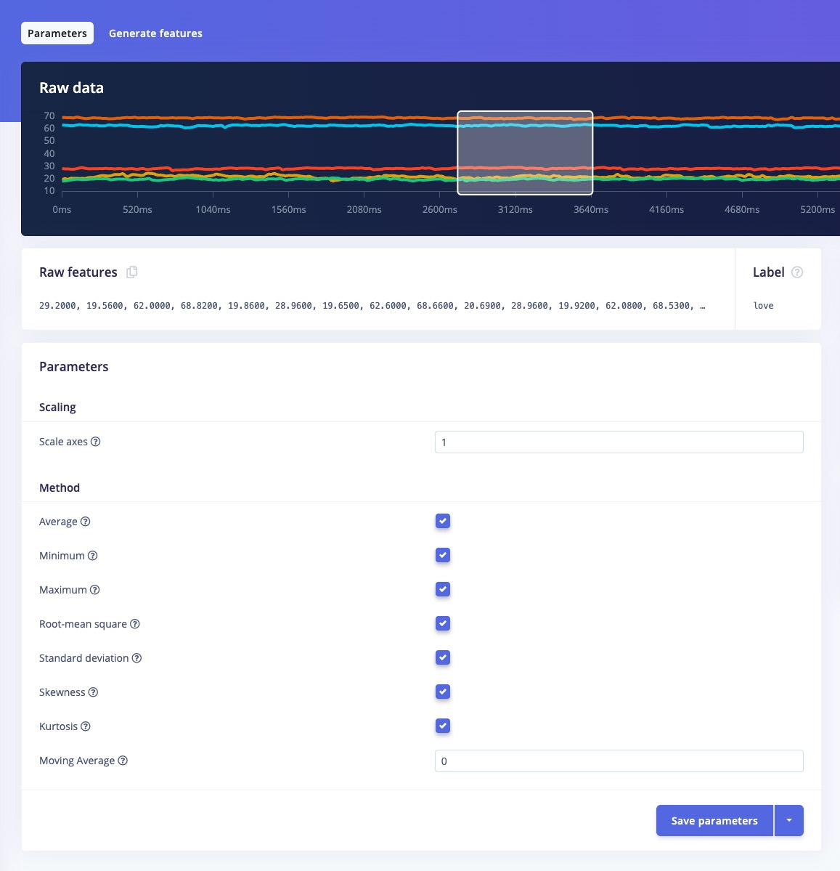
Data Processing Pipeline
Data Collection: 50Hz sampling rate, capturing finger bending angles and hand posture (Arduino & Edge Impulse)
Data Preprocessing: Low-pass filtering (α=0.3), data normalization (Arduino)
Feature Extraction:
Sliding window technique (window size=50)
7 statistical features per sensor (mean, min, max, RMS, std dev, skewness, kurtosis)
Inference Execution: Inference performed every 300ms, confidence threshold 0.60 (Arduino)

Slide 6
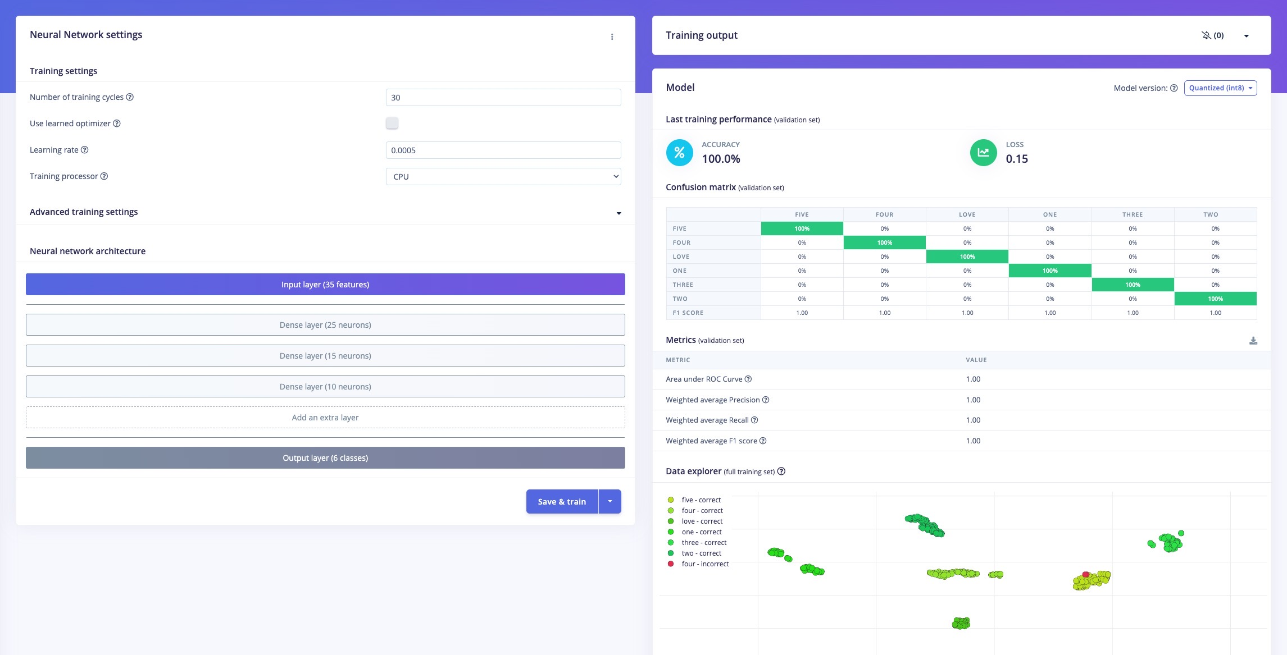
Model Training & Optimization
Model Architecture:
Input layer: 35 features (5 sensors × 7 statistics)
Middle layers: Multiple dense layers
Output layer: Classification for 6 sign language gestures

Slide 7
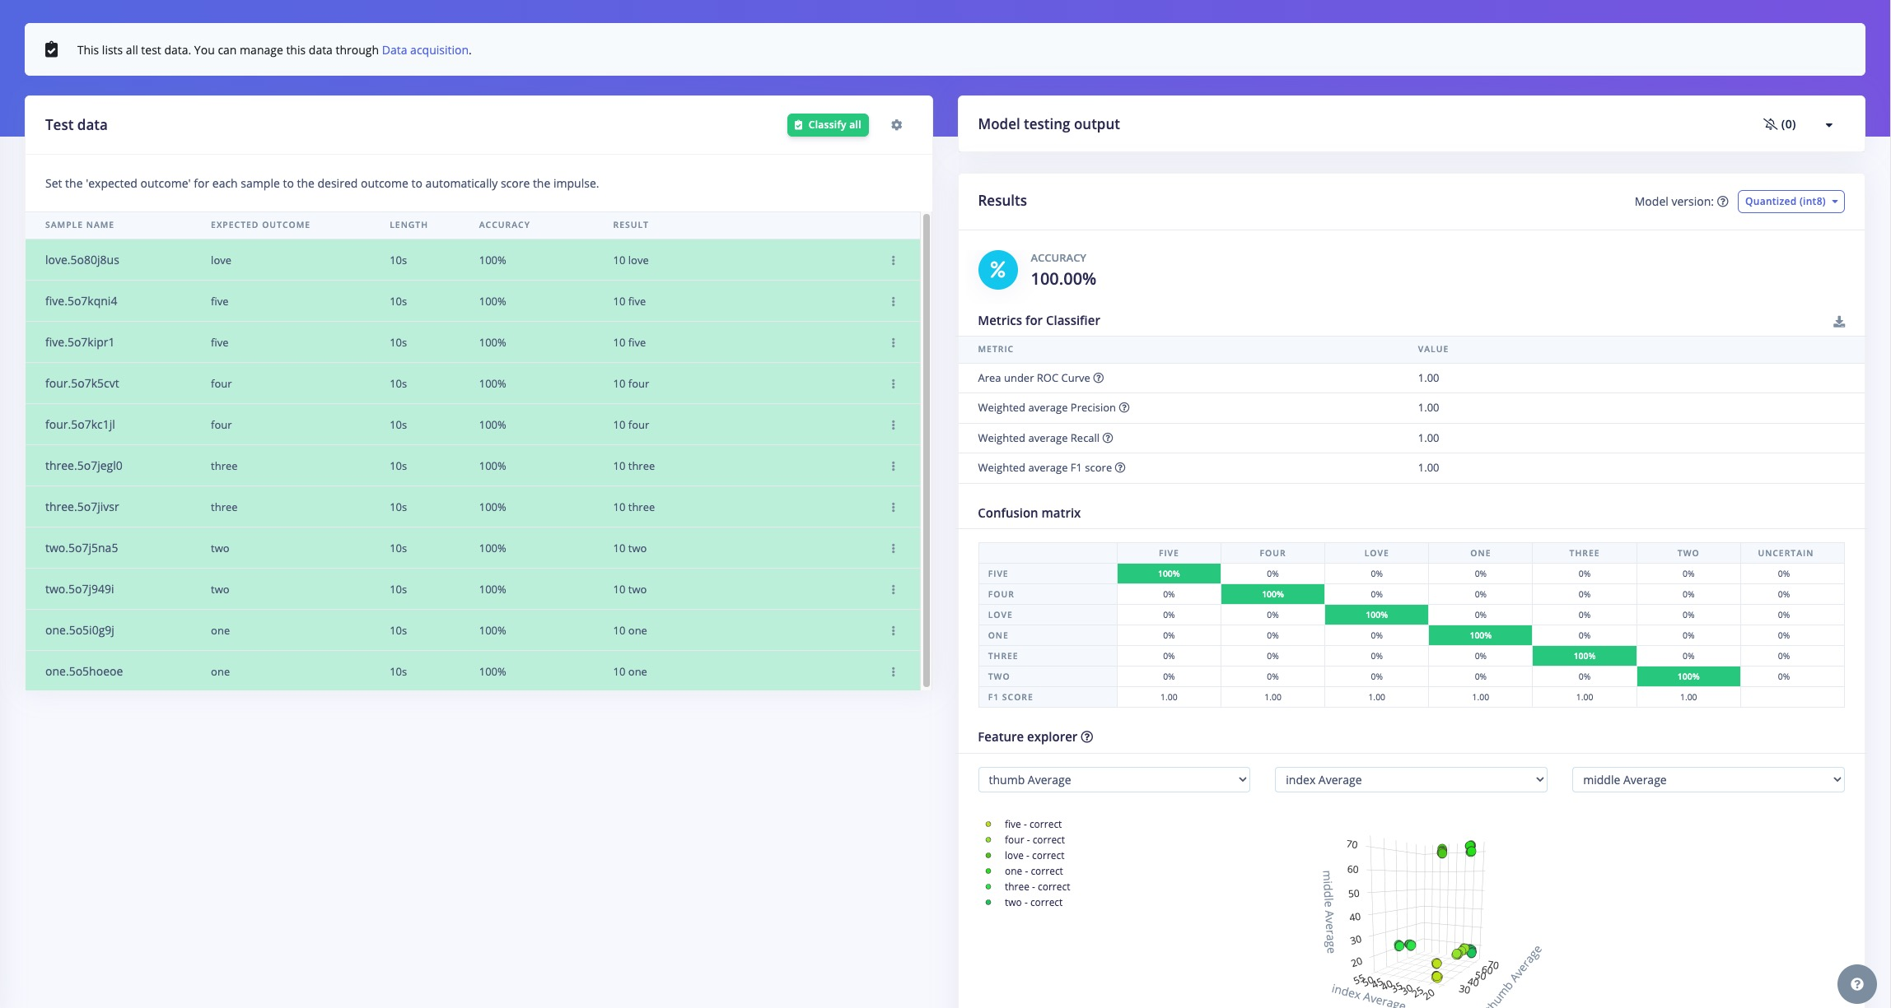
Experimental Results & Performance Analysis
System Performance:
Recognition accuracy: 100% (test set)
Response time: <500ms
Supported gestures: Numbers 1-5, love gesture

Slide 8
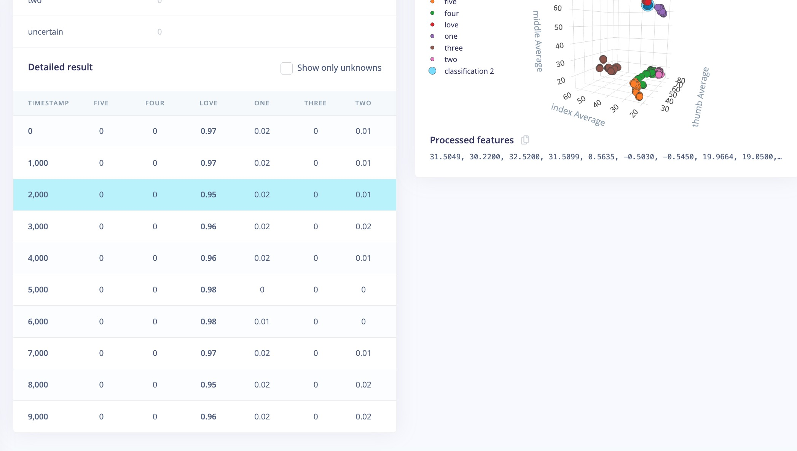
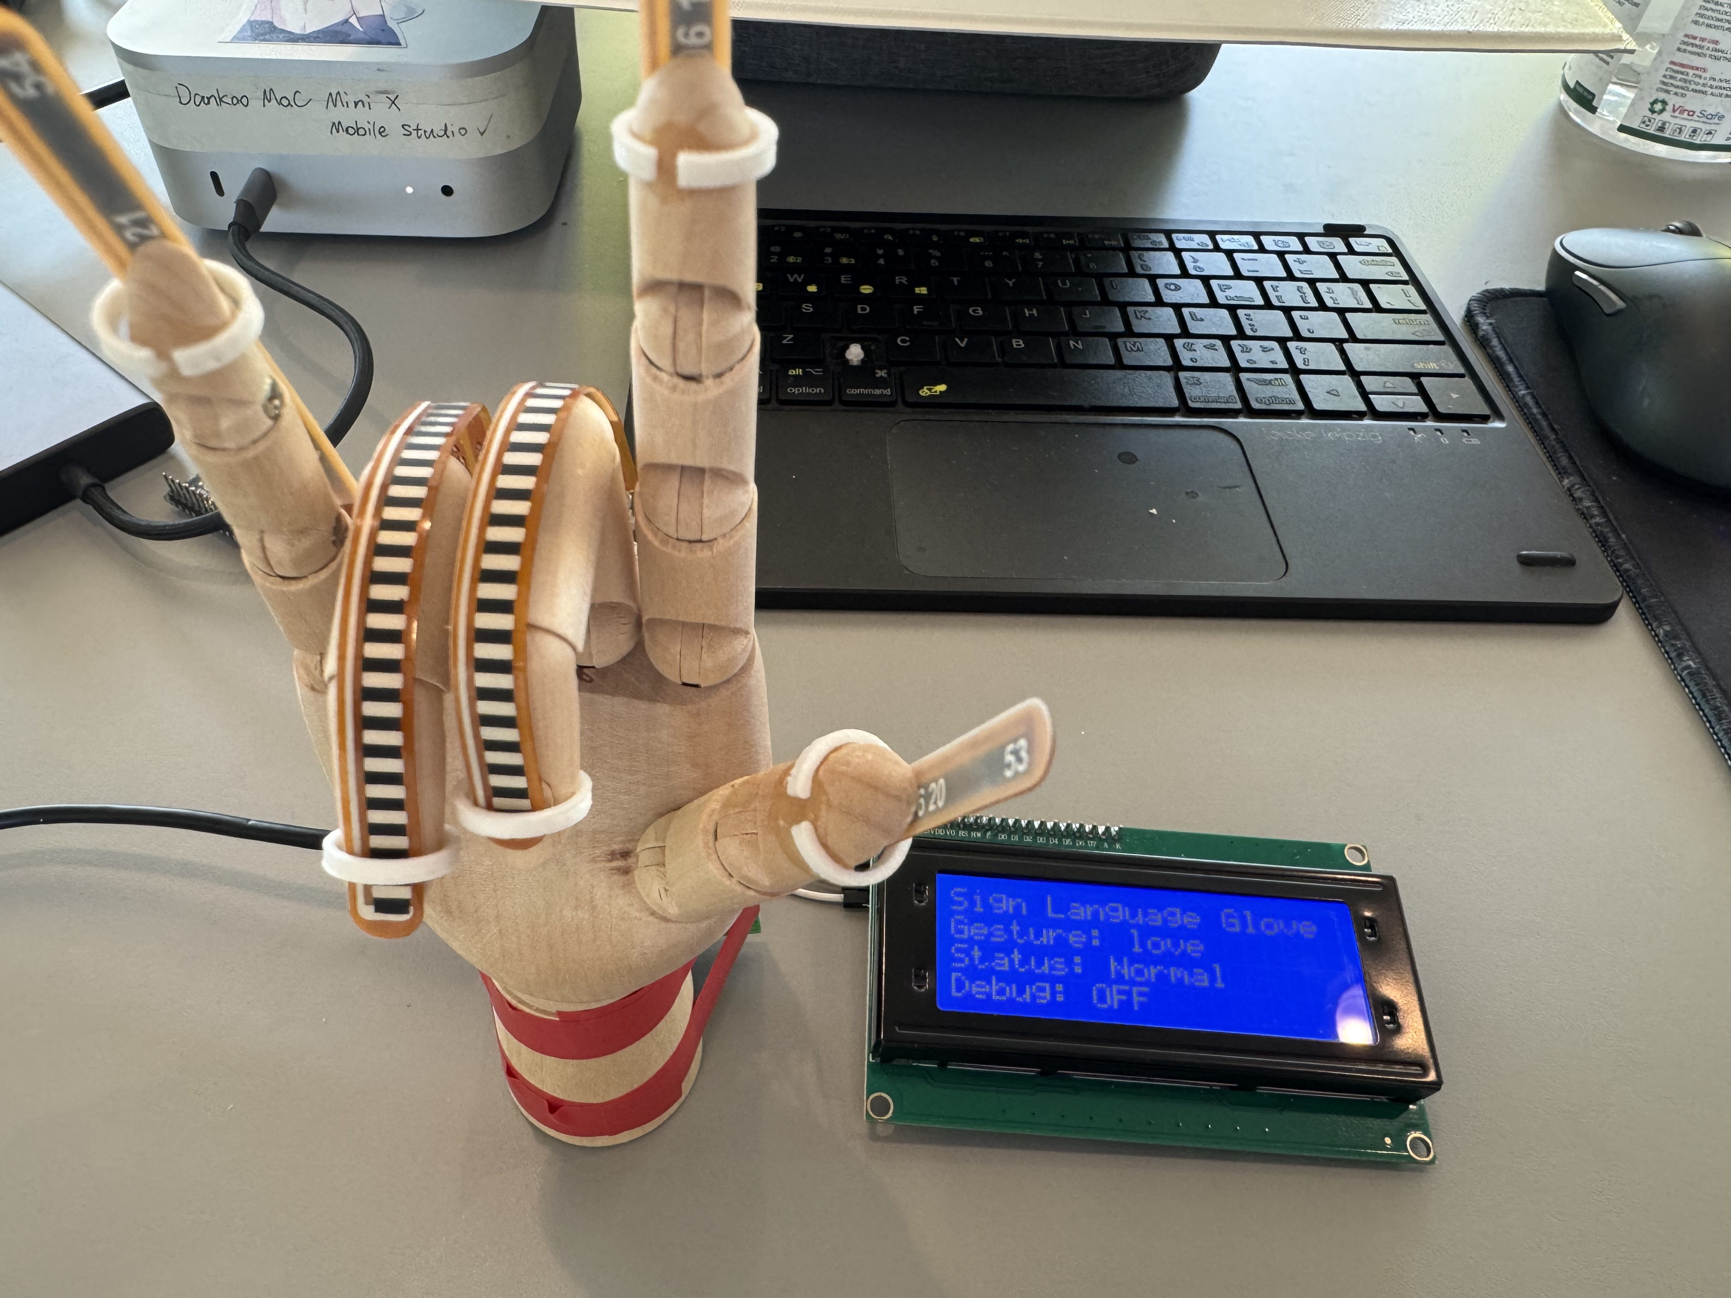
Experimental Results & Performance Analysis
Live Classification:
Example: Love Gesture
LOVE maintains a confidence level of over 95%, indicating that the recognition performance is quite good

Slide 9
Key Challenges & Solutions
Technical Challenges:
Model Input Format Matching
Solution: Feature extraction and standardization
Sensor Drift & Calibration
Solution: Configurable calibration values and adaptive calculation
Optimization in Resource-Constrained Environment
Solution: Algorithm optimization, conditional compilation
Balance Between Real-time and Accuracy
Solution: Sampling rate optimization, stability count mechanism

Slide 10
Project Limitations & Future Improvements
Current Limitations:
Limited number of supported gestures (only 6)
Only supports static gesture recognition
Large variations in gesture expression between users
Sensor aging affects performance
Future Improvements:
Expand gesture vocabulary
Support dynamic gesture recognition

Slide 11
Conclusion & Reflection
Project Highlights:
Successfully implemented TinyML based embedded sign language recognition
Achieved complex gesture recognition on resource-constrained platforms
Modular design facilitates extension and improvement
Social Impact:
Assists daily communication for the hearing impaired
Promotes accessible communication technology development
"The ultimate goal of technology is to create a more inclusive and accessible communication environment"

Slide 12
Reference
Min, Y., Hao, A., Chai, X., and Chen, X. (2021). “Visual alignment constraint for continuous signlanguage recognition”. In: proceedings of the IEEE/CVF international conference on computer vision, pp. 11542–11551.
World Health Organization (2023). Deafness and hearing loss. Accessed: 17 April 2025. Available from: https://www.who.int/news-room/fact-sheets/detail/deafness-and-hearing-loss.

Slide 13

Thank You!
Project Code: https://github.com/Reikimen/CASA0018-Gloves-Edge-AI
Contact Information:
Email: dankao.chen@ucl.ac.uk
GitHub: @Reikimen

